Slide 1
HAKO Spare Parts Catalog:
Step One:
- Download zip, or open unzipped folder
- Folder Name is base-cad_85001993
- Double click folder to open
- Scroll down and click on " AutoStart.exe
- Once open change language to English.
- Click Start Catalog to just run without installing
- Click Install to add to your PC if needed as well
- Update manager box click cancel
- Program now up and running

Slide 2
Double Click

Slide 3
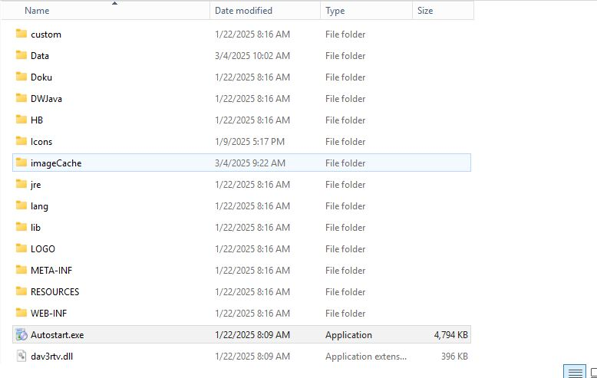
Double Click “Autostart.exe”

Slide 4

Change to English:

Slide 5
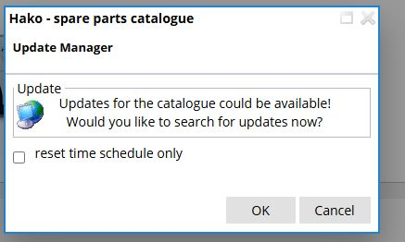
Click Cancel”

Slide 6
